Slide 1
Getting to Know Your Data
Data Preprocessing
Ravi Starzl, PhD
Based on the content of the book Data Mining: Concepts and Techniques By Jiawei Han, Micheline Kamber, and Jian Pei. 3rd edition, Morgan Kaufmann, 2012.

Slide 2
Statistical Descriptions in Data Mining
Statistical methods summarize or interpret data.
Methods include mean, median, mode, standard deviation.
Relevance: Understanding data distribution aids in preprocessing and algorithm selection.

Slide 3
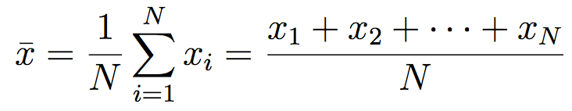
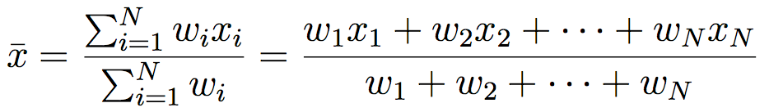
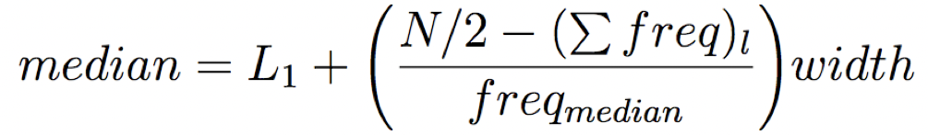
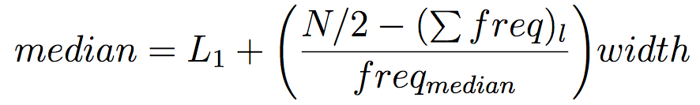
Central Tendency
Mean
Weighted arithmetic mean
Trimmed Mean: chopping extreme values
Median
middle value if N is odd, otherwise average of the middle two values.

Slide 4
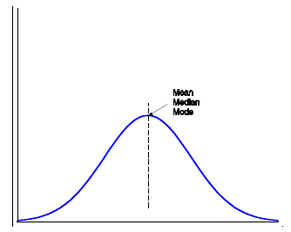
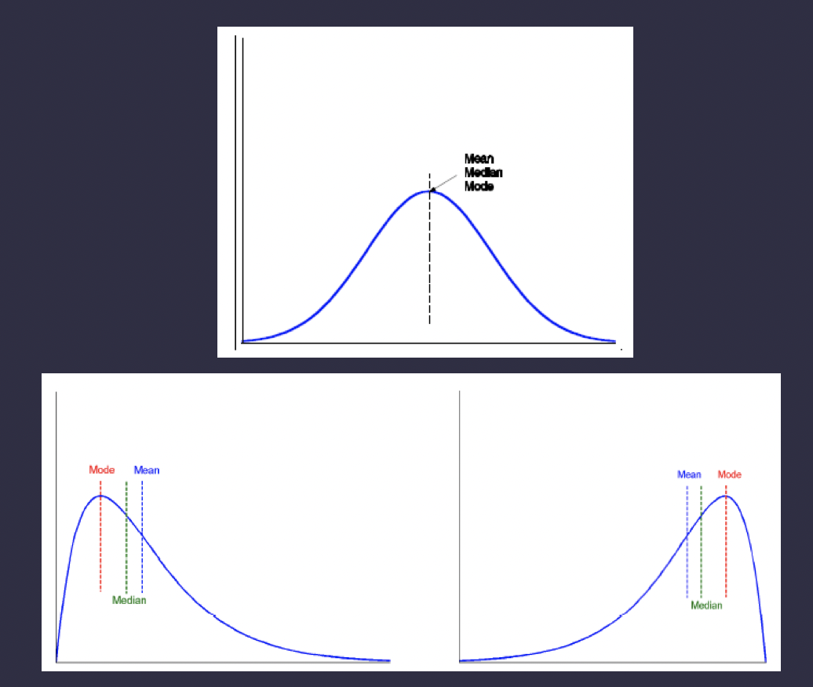
Central Tendency
Mode: value that occurs most frequently
unimodal, biomodal, trimodal, multimodal
Midrange: avg. of min and max

Slide 5
Variance and Skewness
Variance measures data dispersion. Skewness indicates asymmetry.
Relevance: Helps in identifying outliers and data normalization.

Slide 6
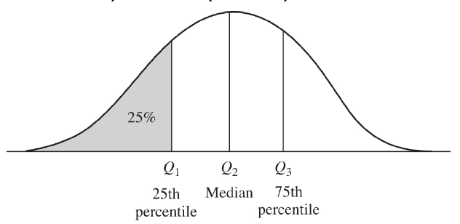
Data Dispersion
How much numeric data tend to spread
Range: difference between max and min
Quartiles: Q1 (25th percentile), Q3 (75th)
Interquartile range
IQR = Q3 - Q1

Slide 7
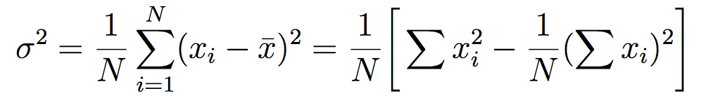
Data Dispersion
Five number summary: min, Q1, median, Q3, max
Outlier: value higher/lower than 1.5 x IQR of Q3/Q1
Variance:
Standard deviation: square root of variance

Slide 8
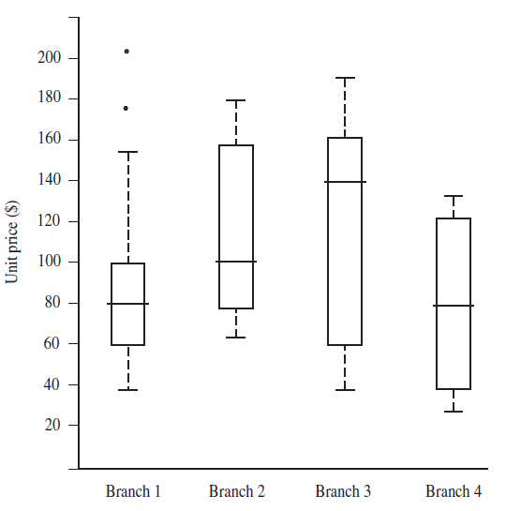
Data Dispersion
Boxplot
box: Q1, M, Q3, IQR
whiskers:
min, max, 1.5 x IQR
outliers

Slide 9
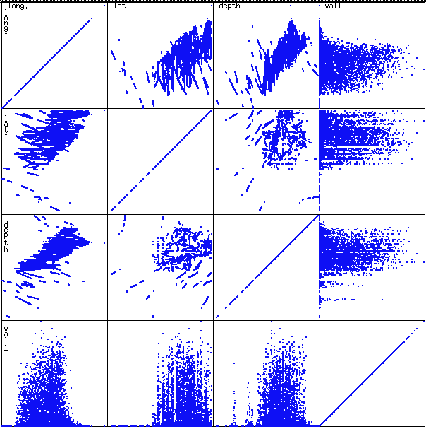
Data Visualization Techniques
Common techniques: histograms, scatter plots, heat maps.
Utility: Quick insight into data, helps in feature selection.
Choice depends on data type and mining objectives.

Slide 10
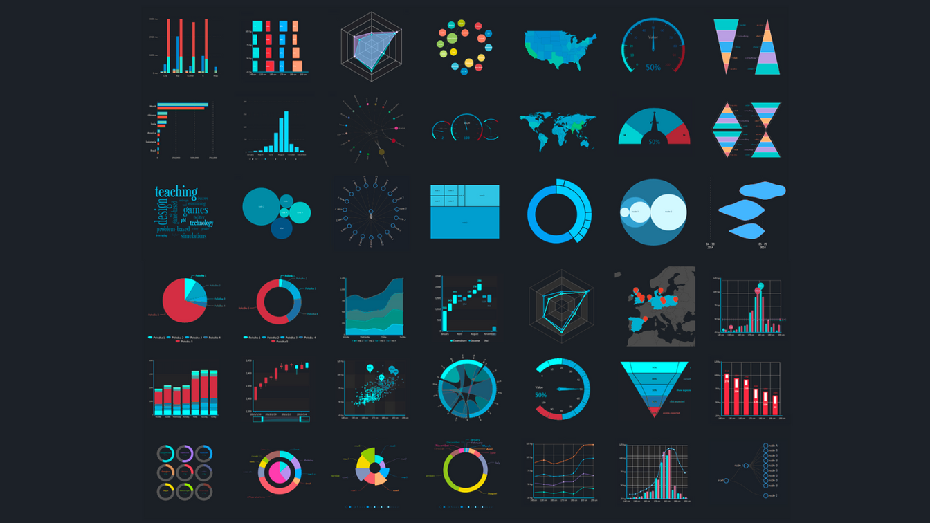
More on Data Visualization
Additional techniques: Box plots, violin plots.
Relevance: Useful for comparing distributions and identifying outliers.

Slide 11
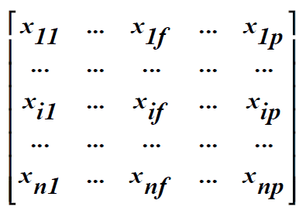
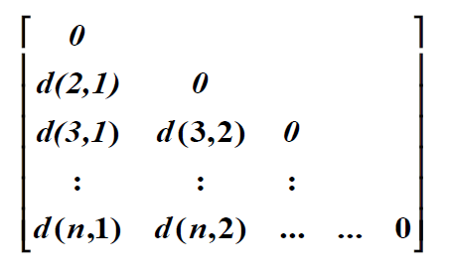
Measuring Data Similarity
Data matrix
object-by-attribute
two modes
Dissimilarity matrix
object-by-object
one mode

Slide 12
Object Similarity/Dissimilarity
Usually measured by distance
Minkowski distance (Lp norm)
Euclidean distance (L2 norm)
Usually measured by distance
Minkowski distance (Lp norm)

Slide 13
Understanding Attribute Types
Attributes describe data objects. Types include nominal, binary, ordinal, numeric.
Importance: Type determines applicable mining operations.
Example: Nominal attributes suitable for clustering, not for mathematical operations.

Slide 14
Real-world Applications of Attribute Types
Nominal: Market segmentation.
Binary: Fraud detection.
Ordinal: Customer satisfaction surveys.
Numeric: Financial forecasting.

Slide 15
Numeric Attributes in Data Mining
Numeric attributes: interval-scaled and ratio-scaled.
Discrete vs. Continuous: Affects data storage and processing.
Importance: Precision and range impact algorithm performance.

Slide 16
Machine Learning Algorithms and Numeric Attributes
Algorithms such as k-NN and SVM are sensitive to attribute scales.
Normalization or standardization often required.

Slide 17
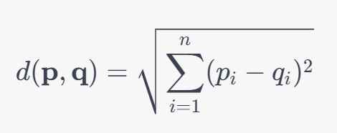
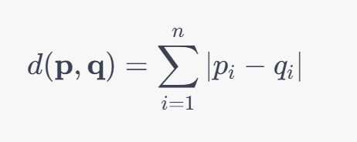
k-Nearest Neighbors (k-NN)
k-NN is a type of instance-based learning, where the algorithm classifies new instances based on the classes of the nearest training instances.
Distance Metrics:
The most common distance metrics used in k-NN are:
Euclidean Distance:
Manhattan Distance:
Sensitivity to Scale:
Different attributes might have different scales. For example, one attribute might range between 0 and 1, while another attribute might range between 0 and 1000. When calculating distance, the attribute with a larger range can dominate the distance calculation, making the algorithm insensitive to variations in attributes with smaller ranges.
To mitigate this, feature scaling (like min-max scaling or standardization) is usually applied to bring all attributes to similar scales.

Slide 18


Support Vector Machine (SVM)
SVM tries to find the optimal hyperplane that separates the classes in the feature space.
Kernel Function:
In many cases, SVM employs kernels to carry out transformations. The popular kernels are:
Linear Kernel:
Radial Basis Function (RBF) Kernel:
Sensitivity to Scale:
The decision boundary in SVM is influenced by the scale of the features. Features with a larger range can dominate the optimization process, potentially leading to sub-optimal decision boundaries.
Similar to k-NN, feature scaling is essential to ensure that all features contribute equally to the decision boundary.

Slide 19
Attribute Scales Conclusion
Both k-NN and SVM are sensitive to the scale of the attributes due to the influence of attribute scales on the distance metrics (k-NN) and the kernel functions (SVM).
It's common practice to apply feature scaling before training these algorithms to ensure a fair contribution from all features and potentially achieve better performance.

Slide 20
What is a Kernel?
A kernel, in the context of machine learning, is a function that computes a dot product in some (possibly infinite) feature space. Using kernel functions allows one to operate in a high-dimensional space without explicitly computing the coordinates of points within that space, which can sometimes lead to computational savings.

Slide 21




A Few Popular Kernel Functions
1. Linear Kernel
The linear kernel is simply the inner product of two vectors. For vectors x and y, it is defined as:
2. Polynomial Kernel
The polynomial kernel, which computes the dot product in a polynomially expanded feature space, is defined as:
where d is the degree of the polynomial.
3. Radial Basis Function (RBF) or Gaussian Kernel
The RBF kernel, also known as the Gaussian kernel, is defined as:
where γ is a parameter that determines the width of the Gaussian.
4. Sigmoid Kernel
The sigmoid kernel is defined as:
where α is a scaling parameter and c is a constant.

Slide 22
Kernels
Applications
Kernel functions have several applications, notably in kernelized support vector machines (SVMs), kernel principal component analysis (PCA), and Gaussian processes. They allow these algorithms to create non-linear decision boundaries and find complex patterns in the data.
Properties
For a function to be a valid kernel, it must satisfy Mercer's conditions, which imply that the corresponding Gram matrix (a matrix where each element is the kernel evaluated at a pair of data points) is positive semi-definite for any possible dataset. This ensures that the optimization problems that use kernels (like the SVM training problem) are well-posed.

Slide 23
Kernel Trick
The kernel trick is a technique in machine learning that involves using a kernel function to map data into a higher-dimensional feature space, making it easier to classify the data linearly. This is especially useful in algorithms such as support vector machines (SVMs) and is pivotal in enabling non-linear classification or regression.

Slide 24

Kernel Trick
Step 1: Mapping to a Higher Dimensional Space
Given a dataset that is not linearly separable in its original feature space, we seek a transformation ϕ that maps the data into a higher-dimensional space where it might be linearly separable. Mathematically, this mapping can be denoted as:
where n is the dimensionality of the original space, and m is the dimensionality of the transformed space (usually m>n).

Slide 25

Kernel Trick
Step 2: Using Kernel Functions
Computing the dot products in this higher-dimensional space can be computationally intensive, especially if m is much larger than n. This is where the kernel trick comes in handy. Instead of explicitly computing the mapping ϕ and then computing the dot product, we use a kernel function K that computes the dot product directly in the original space, i.e.,
Here, ⟨⋅,⋅⟩⟨⋅,⋅⟩ denotes the dot product in the higher-dimensional space, and x and y are vectors in the original space.

Slide 26
Kernel Trick
Step 3: Solving the Problem in the Original Space
With the kernel function at our disposal, we can now solve the problem (e.g., training an SVM) in the original space without ever explicitly computing the mappings ϕ(x) and ϕ(y). This not only saves computational time but often allows us to work with infinite-dimensional spaces, which would not be possible without the kernel trick.

Slide 27
Data Preprocessing
Processes include data cleaning, transformation, normalization.
Relevance: Enhances data quality, improves mining performance.
To Be continued…

